Slide 1
CSE322
Formal Languages and Automation Theory
Lecture: PDA
School of Computer Science and Engineering

Slide 2
Description of PDA Model
Formal Definition of PDA:
P={Q, Σ, Γ,q0,Z,F, δ}
A Pushdown Automata (PDA) can be defined as :
Q is the set of states
∑is the set of input symbols
Γ is the set of pushdown symbols (which can be pushed and popped from stack)
q0 is the initial state
Z is the initial pushdown symbol (which is initially present in stack)
F is the set of final states
δ is a transition function which maps Q x {Σ ∪ ∈} x Γ into Q x Γ*.

Slide 3
Design PDA
P={Q, Σ, Γ,q0,Z,F, δ}
L={O^n 1^2n , n>0}
Take one string from given Language:
Start with initial state, at the time Tau in stack at Z0
ε
0 | 0 | 1 | 1 | 1 | 1
q0
Z0
Γ
Stack

Slide 4
Design PDA
P={Q, Σ, Γ,q0,Z,F, δ}
L={O^n 1^2n , n>0}
Take one string from given Language:
We have input 0, so tau at Z0 (i.e. 0,Z0).
Now in PDA, Machine first POP Z0, then it
will reinsert Zo and 0 in Stack.
ε
0 | 0 | 1 | 1 | 1 | 1
0,Z0/0Z0
q0
0
Z0
Γ

Slide 5
Design PDA
P={Q, Σ, Γ,q0,Z,F, δ}
L={O^n 1^2n , n>0}
Take one string from given Language:
We have input 0, so tau at 0 (i.e. 0,0).
Now in PDA, Machine first POP 0, then it
will reinsert 0 and 0 in Stack.
ε
0 | 0 | 1 | 1 | 1 | 1
0,Z0/0Z0
q0
0,0/00
0
0
Z0
Γ

Slide 6
Design PDA
P={Q, Σ, Γ,q0,Z,F, δ}
L={O^n 1^2n , n>0}
Take one string from given Language:
We have input 1, so tau at 0 (i.e. 1,0).
Now in PDA, Machine first POP 0 and reinsert
0 again, then move towards new state
ε
0 | 0 | 1 | 1 | 1 | 1
0,Z0/0Z0
0,0/00
q0
q1
0
0
Z0
1,0/0
Γ

Slide 7
Design PDA
P={Q, Σ, Γ,q0,Z,F, δ}
L={O^n 1^2n , n>0}
Take one string from given Language:
We have input 1, so tau at 0 (i.e. 1,0).
Now in PDA, Machine first POP 0 and reinsert
ε, then move towards new state
ε
0 | 0 | 1 | 1 | 1 | 1
0,Z0/0Z0
0,0/00
q0
q1
q2
0
Z0
1,0/ ε
1,0/0
Γ

Slide 8
Design PDA
P={Q, Σ, Γ,q0,Z,F, δ}
L={O^n 1^2n , n>0}
Take one string from given Language:
We have input 1, so tao at 0 (i.e. 1,0).
Now in PDA, Machine first POP 0 and reinsert
0 again, then move towards previous state
ε
0 | 0 | 1 | 1 | 1 | 1
0,Z0/0Z0
1,0/ ε
0,0/00
q0
q1
q2
0
Z0
1,0/ ε
1,0/0
Γ

Slide 9
Design PDA
P={Q, Σ, Γ,q0,Z,F, δ}
L={O^n 1^2n , n>0}
Take one string from given Language:
We have input 1, so tau at 0 (i.e. 1,0).
Now in PDA, Machine first POP 0 and then
reinsert ε and move towards next state
ε
0 | 0 | 1 | 1 | 1 | 1
0,Z0/0Z0
1,0/ ε
0,0/00
q0
q1
q2
Z0
1,0/ ε
1,0/0
Γ

Slide 10
Design PDA
P={Q, Σ, Γ,q0,Z,F, δ}
L={O^n 1^2n , n>0}
Take one string from given Language:
We have input ε, so tau at Z0 (i.e. ε,Z0).
Now in PDA, Machine first POP Z0 and then
move towards final state
q3
ε
0 | 0 | 1 | 1 | 1 | 1
ε,Z0/Z0
0,Z0/0Z0
1,0/ ε
0,0/00
q0
q1
q2
Z0
1,0/ ε
1,0/0
Γ

Slide 11
Design PDA
P={Q, Σ, Γ,q0,Z,F, δ}
L={O^n 1^2n , n>0}
Take one string from given Language:
We have not input, and tau at ε (i.e. Stack
empty) So process done.
q3
0 | 0 | 1 | 1 | 1 | 1
ε,Z0/Z0
0,Z0/0Z0
1,0/ ε
0,0/00
q0
q1
q2
1,0/ ε
1,0/0
Γ

Slide 12
DPDA and NPDA
We can create NPDA for all CFL, but cant create DPDA for all CFL.
As we know, PDA is nothing but Finite automata + Stack.
DPDA: QxεxΓ →QΓ*
NPDA: QxεxΓ →2^QΓ*
NPDA is powerful then DPDA

Slide 13

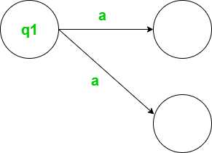
Cont…
DPDA: For every input with the current state, there is only one move.
For every input with the current state, We can have multiple moves.

Slide 14
LL(k) and LR(K) Grammars
Top-down and Bottom-up Parsers
The term "LL(k) grammar" refers to a class of context-free grammars in formal language theory.
In the context of automata theory, LL(k) grammars are a subset of context-free grammars that can be parsed by a certain type of parsing algorithm called LL(k) parsing.
L: Stands for Left-to-right scanning of the input.
L: Stands for Leftmost derivation. This means that when constructing a parse tree, the leftmost non-terminal symbol is always the one expanded first.
(k): The 'k' represents the number of look ahead symbols the parser uses to make parsing decisions. In LL(k) parsing, the parser looks at 'k' symbols of the input to decide which production to use.

Slide 15
Cont…
LR(k) grammars are a class of context-free grammars that are more powerful than LL(k) grammars. LR(k) parsers are capable of parsing a larger set of grammars, including many programming languages. In LR(k) parsing, 'L' stands for scanning the input from left to right, 'R' stands for constructing a rightmost derivation in reverse (hence, "LR"), and 'k' represents the number of lookahead symbols used for making parsing decisions.
An LR(k) grammar allows an LR(k) parser to decide which production to apply based on the current input symbol and k lookahead symbols. These parsers can handle a broader range of grammars than LL(k) parsers.

Slide 16
Cont…
In LLK and LRK, first L known as left to right reading and remaining L and R known as below,
LMD and RMD
S→aAbBe
Then If we picking A variable (nonterminal), then it will known as LMD.
If we picking B Variable then it will known as RMD.
LMD follow Top-Down and RMD follow Bottom up

Slide 17
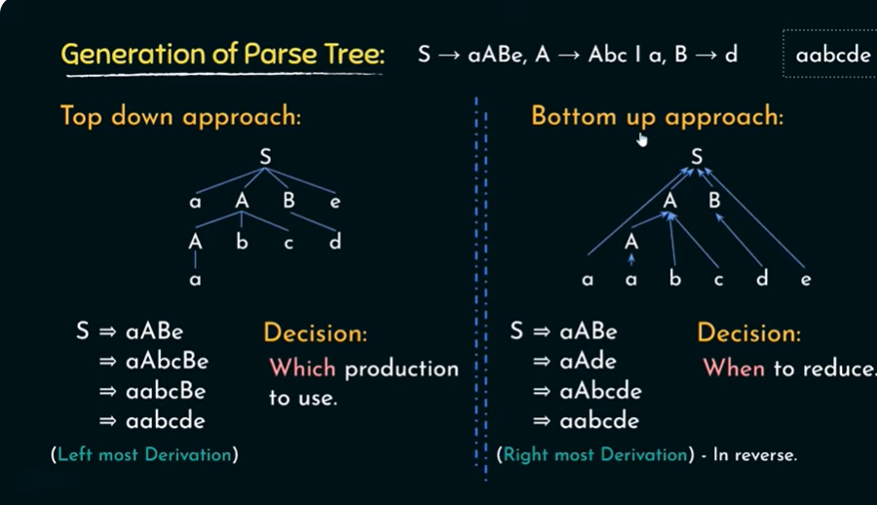

Slide 18
Properties of LL(k) Grammars
Predictive Parsing: LL(k) grammars can be parsed using a top-down, left-to-right parsing strategy with a lookahead of k symbols. This means that you can predict the production to apply based on the current non-terminal and the next k input symbols.
Leftmost Derivation: LL(k) grammars are parsed using leftmost derivation, where at each step, the leftmost non-terminal in the current production is expanded. This property simplifies parsing and leads to efficient LL(k) parsers.
No Backtracking: LL(k) parsers do not require backtracking. Once a production is chosen, there is no need to undo or backtrack the parsing process. The parsing decision is made deterministically based on the current symbol being parsed and the lookahead symbols.
LL(1) Grammars: A subset of LL(k) grammars is LL(1) grammars, where the parsing decision is based on a single lookahead symbol (k=1). LL(1) grammars are particularly useful because of their simplicity, and many programming languages can be described by LL(1) grammars.
Parsing Table: LL(k) grammars can be represented by a parsing table. This table guides the parsing process by indicating which production to use for a given non-terminal and lookahead symbol. If there are no conflicts in the table, the grammar is LL(k).

Slide 19
Properties of LR(k) Grammars
Property 1 : Every LR(k) grammar G is unambiguous.
There exists a unique right-most derivation. Any pushdown automaton accepts a context- free language and for any context-free language L, we can construct a pushdown automaton accepting L.
Property 2 If G is an LR(k) grammar. there exists a deterministic pushdown automaton A accepting L(G).
Property 3 If A is a deterministic pushdown automaton A, there exists an LR(l) grammar G such that L(G) =N(A).
Property 4 If G is an LR(k) grammar, then there exists LR(K’) such that K’>K
Property 5 The class of deterministic languages is a proper subclass of the class of context-free languages.
Property 6 LR(k) is closed under complementation but not under union and intersection.

